Slide 1



ENGR 240
Setting up the Proposal:
Problem Definition
Monika Smith
Assistant Teaching Professor
Department of English

Slide 2
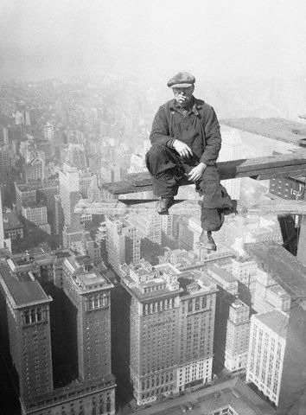
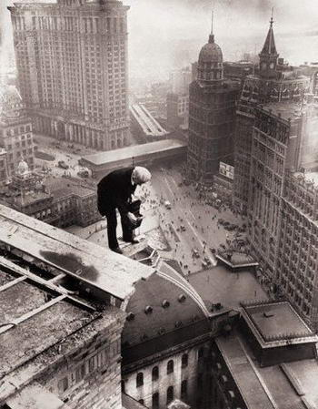

When you Learn to Write Proposals, you Can Change the World!
These visuals depict daily scenes of workers between 1920 and 1935
who helped build America’s skyscrapers
The next visual shows workers today cleaning the windows of those skyscrapers . . .

Slide 3
Learning Outcomes
Having gone through these slides and completed the Writing Prompts, you should be able to
Identify and describe the FOUR individual components of a Problem Definition Statement
Recognize the vital role of a clearly defining the problem so your solution aligns with the deliverables the client and other stakeholders are looking for
In short, it’s important to recognize that while an excellent problem definition may not result in you winning a proposal bid, a poor problem definition will likely cause you to lose it—regardless of the merits of the rest of the proposal!
Draft a problem definition in all its component parts: Need, Goal, Objectives, and Constraints

Slide 4
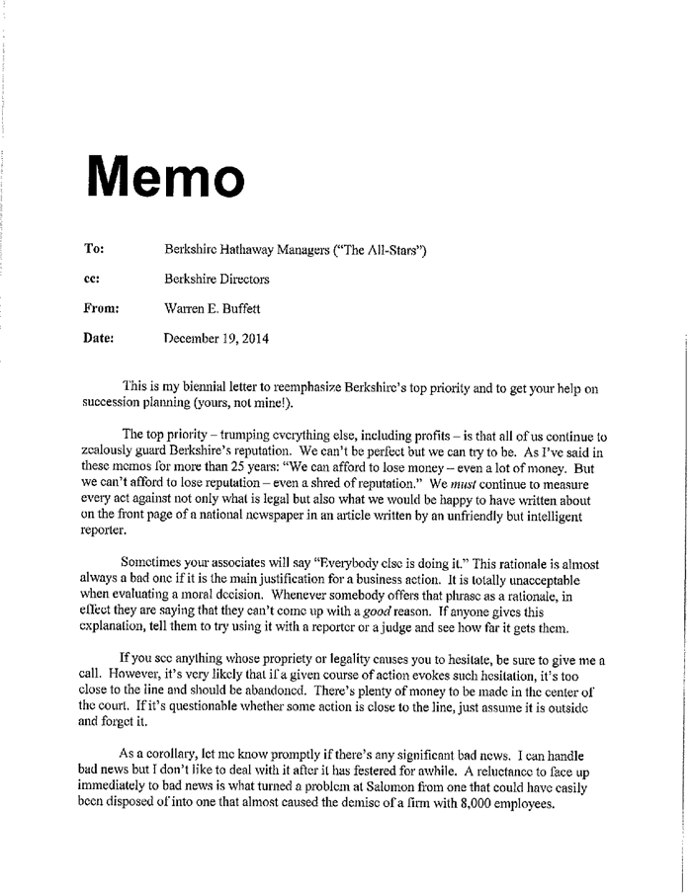
These and my following slides cover each section of a proposal in detail, providing examples and Writing Prompts to help you successfully compose your proposal
Begin by downloading a MEMO Template

Slide 5
Follow Procedures to Align with the Client RFP
Different Projects, Different Proposals, Different Tasks . . .
But Same
Basic Structure or Template
Problem Definition
Plan of Action: What you will do
How long it will take to do
The Cost of doing it
Your qualifications for doing it

Slide 6
Present a Complete Problem Definition
PROBLEM DEFINITION
1.1 Need Statement
1.2 Goal
1.3 Objectives
1.4 Constraints
Problem Definition
in all its parts forms the Introductory material of your proposal
Finally end with the potential benefits of solving the problem

Slide 7
Then Supply the Main Body
PLAN OF ACTION:
The Plan of Action details how you’re going to tackle the problem: your design solution for remedying the Need and the practical logistics of actually implementing it
2.1 Technical Plan
Identify what you will actually do, create, or build: in your case, this is where you describe your research plan for investigating your idea for reducing plastic waste on UVic campus
2.2 Management Plan
Show how the technical plan just described will be implemented:
2.2.1 Your time-frame for researching it
2.2.2 The costs of doing it
2.2.3 Your qualifications for doing it

Slide 8
Then Present the Concluding Section . . .
3. CONCLUSION:
Now you recap the whole thing
And you’re done!
4. REFERENCES: Supply a References list citing all your information to avoid plagiarising, even accidentally

Slide 9
Begin with a Problem Definition
It’s now time to move onto drafting the all-important Problem-Identification
Having identified your audience and drafted your topic+ purpose, you must now identify the Client Need you intend to meet
The following slides guide you in laying out the opening Problem Definition
Refer to these slides closely when composing this all-important segment of a proposal to fully meet requirements and earn good grades

Slide 10
First Identify the Need (CEAB)
“Engineering design integrates mathematics, natural sciences, engineering sciences, and complementary studies in order to develop elements, systems, and processes to meet specific needs…”
Canadian Engineering Accreditation Board

Slide 11

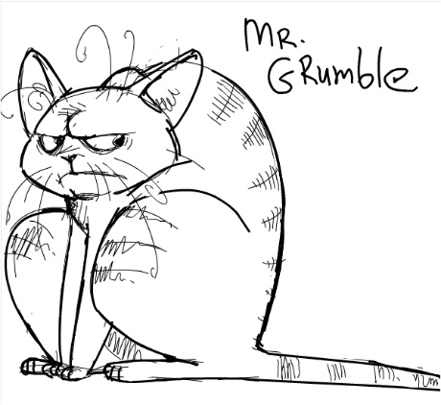
Then Formulate a Need Statement
To help clarify your understanding of a need statement, Dr. Hyman (Fundamentals of Engineering Design) offers the following prompt:
“Articulate the need as an expression of dissatisfaction
with the current situation” [p. 42]
Think of it as a chance to grumble and complain . . .

Slide 12

Formulate a NEED Statement: Focus on What’s Lacking
Need Statement: Describe the current situation in terms of what a technology that the client currently lacks or doesn’t have (that ideally they could or should have—and that you intend to supply!) Focus on negatives:
Negative Need
For example:
What did the old Johnson Street Bridge NOT provide:
what did it lack?
what did it not do
What did it not have?
What was absent or missing?
Think of the Need Statement in terms of an old-fashioned roll of film: it provides the negative image of the thing you aim to provide (in the Goal Statement . . . )

Slide 13
Formulate a NEED Statement: Focus on What’s Lacking
For example *
The heating system directly beneath B150 does not come with effective sound baffle. Noise from the heating systems directly beneath the room is distracting and can make it difficult to hear the speaker, reducing the effectiveness of B150 as a lecture hall
Conventional materials cannot withstand the extremely high temperatures of reentry and so cannot protect astronauts from the heat that is generated during reentry
The bumper cannot withstand impacts of more than 5 mph
* Lindsay McCardle PhD Candidate, Educational Psychology & Leadership Studies. Visiting Speaker, Engr. 110

Slide 14
Provide Specifics to Illustrate
Define the scope of the troubling or unsatisfactory situation:
Identify costs or outcomes of the current unsatisfactory situation in concrete, measureable terms. This makes your description convincing, showing you understand it, you have the numbers to make sense of it in “real world” terms—and you’re not just making empty claims!
Identify who or what is effected by this lack or absence, and how
What are the consequences of this lack?

Slide 15
What kinds of measurable losses could you refer to?
Time
Costs
Productivity
Safety
Wellbeing
Efficiency
Sustainability
Convenience
Identify who, when, what is negatively affected, and how
If appropriate, broach the negative consequences of keeping things as they are—possible losses, risks, damages, or dangers . . .

Slide 16
Writing Prompt: Draft a NEED Statement
Work on formulating the Need Statement for your proposal. Remember Professor Hyman’s prompt:
“Articulate the need as an expression of dissatisfaction with the current situation”
Broach this “unsatisfactory situation” in terms of what resources, services, equipment, or technology is lacking and who or what is affected by this lack
In short, make the Need Statement answer the following question: what does the client lack or not currently have that makes the situation unsatisfactory?
Review client resources to compose your Need statement; review sample proposals for examples of Need Statements to get the right idea
At no point broach what’s going to improve things: that comes next . . .

Slide 17
Follow up with a GOAL Statement Identifying the Solution
Goal Statement: Here, you present a response: what’s required to meet the Need?
Provide a brief statement that identifies, in general terms, the change that will address the situation (and meet the need)
This should be formulated as ONE goal (preferably in ONE sentence) that explains
“the ideal future state or condition that is envisioned for improving the unsatisfactory state described by the need statement”
The “film negative” is now flipped to its positive side! Identify what you envision for remedying the Need, i.e. the missing or lacking technology that you just identified!

Slide 18
For Example: Goal Statement
The goal is to investigate sensor-based irrigation systems to see if this could help reduce excess water waste on UVic campus
The goal is to determine whether an educational campaign to raise user awareness would reduce energy consumption on UVic campus
The goal is to examine whether reducing or eliminating the daily runtime of digicasters would help UVic meet its sustainability goals

Slide 19
GOAL Statement: What Has to be Supplied?
For example:
The goal is to determine the feasibility of designing a food sourcing app that can help students locate menus and seating availability at campus outlets.
For example:
The goal is to study whether implementing a re-usable mug program is a feasible option for reducing paper waste on campus.
For example:
The goal is to investigate whether educational notices in washrooms would be effective in reducing paper waste on campus
Keep it short: ONE SENTENCE!

Slide 20
Writing Prompt: Draft a Goal Statement
Formulate a ONE sentence Goal Statement for your proposal
Without yet going into detail, briefly describe the potential solution or “correction” you wish to investigate to resolve the unsatisfactory situation, i.e. you now identify what you plan to study to remedy the client Need
Review client resources, as well as student sample Proposals to get a clear idea of how to write a strong Need and Goal statement

Slide 21
Follow up with an Objectives Statement
Objectives
Here, you outline key performance characteristics: features, capabilities, or expectations that the proposed design solution should be able to perform, achieve, or carry out
Use future conditional to describe these features (as they don’t yet exist!): should or would have; what it could, should, or would do; what it could supply—given that it has not yet been created, it’s still just hypothetical
Follow terms set by an RFP, but
PARAPHRASE (rather than quote) to show the client you’ve understood what’s required—and then cite the RFP as needed!
A clear set of objectives will allow you and the client to determine how well the design solution you propose meets the client’s expectations

Slide 22
For Example . . .
OBJECTIVES
The proposed plan of action should be able to achieve the following:
Help UVic meet sustainability goals laid out in its 2019 Action Plan
Reduce energy consumption on campus
Decrease the university’s carbon footprint
Raise awareness of sustainability goals among the campus community
Notice the use of grammatical parallelism!

Slide 23
Writing Prompt: 0bjectives
Writing Prompt
Identify projected outcomes, or “performance characteristics” of a good design solution: what changes should it be able to do, achieve, or accomplish?
Refer to the client RFP, plus any other client resources as relevant

Slide 24
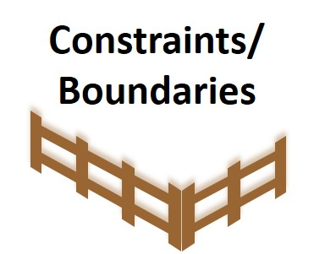

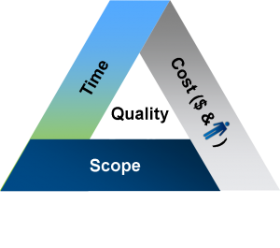
Round up with Given Constraints
Constraints, which are set by a client, refer to limitations that a design solution must abide by, or must NOT do, if it is to be successful. Usually, this includes measurable factors like costs, timeframe, materials, and/ or longevity

Slide 25
Writing Prompt: Draft a Brief Constraints Statement
Your main constraint as imposed by UVic for this project is
A 5-year payback period
A maximum spending limit of $100,000
Writing Prompt
Draft a couple of sentences in which you make note of the given constraints
Your proposed design solution needn’t be large scale; don’t automatically propose something that costs a lot. Small scale solution can be as valuable as large scale ones

Slide 26
Terminology Recap
Need: Describes a current situation that is unsatisfactory: what’s lacking or absent
Goal: Describes a proposed response to the need: the proposed design solution
Objectives: Describes key performance expectations or characteristics
Fundamentals of Engineering Design, B. Hyman, Prentice Hall, 2nd Ed., 2003.

Slide 27
End the Intro with a Benefits Statement
Project clear Benefits to the client of going ahead with your proposal
Briefly state the advantages of undertaking the proposed action, design, or service
Show who or what will benefit and how
As the benefits or advantages you envision are hypothetical at this point, they’re POTENTIALS, not facts per se, you should stick to future modal tense:
Could
Would
Should

Slide 28
Identify what Kinds of Benefits would Accrue
On what basis might positive outcomes be measured and investigated?
Cost
Technology
Safety
Efficiency
Convenience
Security
Social acceptability
Sustainability
Administration
Longevity; durability

Slide 29
Writing Prompt: Draft a Brief Benefits Statement
Draft a couple of sentences identifying the desirability of implementing your proposed study: what it would help the client do, achieve, or accomplish?
For Example
Determining the viability of [insert proposed design solution here] would be a positive step in helping UVic achieve . . .

Slide 30
And with that you’re all done—for now!
CONGRATULATIONS!
You’ve now composed a solid draft of the Proposal’s introductory material: a full and complete Problem Definition!
Be sure to budget time to revise your draft, so that style and expression align with principles of clear plain language . . .

Slide 31
Looking Ahead . . .
It’s now time to move onto the Plan of Action, the core of a successful Proposal!
This will be covered in upcoming slides

Slide 32
Thanks for Going through these Slides!

